Slide 1
Video Game Analysis & Technical Design
  Ch.3 Gameplay & Core Mechanics

Slide 2
Making Games Fun
Execution matters more than innovation
  Games are 50% building & avoiding errors, 35% tuning/polishing,15% variation & innovation
Finding the fun factor…..how do you do it?

Slide 3
A bit more on gamification….
  Jane McGonigal, Reality is Broken (2011)
  “Today, many of us are suffering from a vast and primal hunger. But it is not a hunger for food - it is a hunger for more and better engagement from the world around us....We are starving, and our games are feeding us.”
People learn much more quickly and effectively when immersed in a game.
  By playing a game developed by scientists at the University of Washington, gamers were able to map out a protein that causes AIDS in rhesus monkeys in just 10 days…..a problem that has stumped scientists for 15 years!

Slide 4
A bit more on gamification….
James Paul Gee
  We take it as completely natural that you would be in an Algebra class for 12 weeks, and then I would give you a test on Algebra .... to see if you learned any Algebra. Let’s say a kid plays Halo on Hard .... and finishes Halo. Would you be tempted to give him a Halo test? No. Not at all. You’d say the game already tested him. So let’s think - Why is it that we’re not tempted to give him a Halo test, but we are tempted to give that Algebra test and use that as a judgment? We’ll its because you actually trust the design and learning of Halo better than you trust the design and learning of that Algebra class….

Slide 5
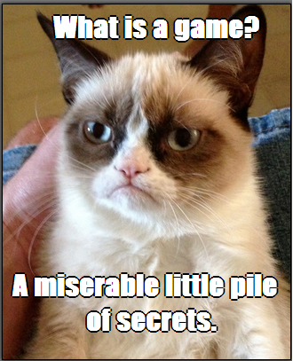
The Hierarchy of Challenges
Hierarchy from lowest to highest
  Atomic challenge
  Sub-mission
  Mission
  Complete the game

Slide 6
The Hierarchy of Challenges
Inform the player about challenges
  Tell the player about explicit challenges
  Players discover implicit challenges on their own
  The most interesting games offer >1 way to win
  Recognize and reward victory achieved no matter how the player achieves it
  Overcoming several atomic challenges at the same time increases the difficulty (e.g. bombard the player with enemies) – this increases the stress
  Intrinsic skill + stress/pressure = absolute difficulty

Slide 7
Commonly Used Challenges
Physical (e.g. reduce time available to increase difficulty)
Logic and mathematical
  Formal logic puzzles
    To increase difficulty, increase the number of objects and the ways they can be manipulated
    Players normally get all the time they need to solve
  Mathematical challenges
    Games require players to reason about probabilities
    Make educated guesses with imperfect knowledge

Slide 8
Commonly Used Challenges
Races (e.g. be first to accomplish a goal)
Factual knowledge challenges (e.g. trivia)
Memory challenges
  To make it easier, give players longer to memorize and test them sooner
Pattern recognition challenges
  To increase difficulty, make the pattern longer, more intricate, or more subtle

Slide 9
Commonly Used Challenges
Exploration challenges
  Spatial awareness challenges
    To decrease difficulty, provide a map
  Locked doors & traps
    Avoid unmarked switches far from the door
  Mazes and illogical spaces
    Every place looks alike and player must discover relationships between the areas
  Teleporters
    To make the challenge easier, make the teleporter predictable and reversible

Slide 10
Commonly Used Challenges
Conflict
  Requires direct opposition of forces
    Strategy
    Tactics
    Logistics
    Survival and reduction of enemy forces
    Defending vulnerable items or units
    Stealth
Economic challenges
  Accumulating resources, achieving balance, caring for living things

Slide 11
Commonly Used Challenges
Conceptual reasoning and lateral thinking puzzles
  Conceptual reasoning puzzles require reasoning and knowledge to solve a problem
  Lateral thinking uses extrinsic knowledge in unexpected ways

Slide 12
Actions
Actions for gameplay
  Most actions are intended to meet challenges
  Games offer fewer actions than challenges to limit size of user interface and animation costs
  Most actions can address more than one type of challenge
  Define actions based on player’s role and actions to overcome challenges
Why allow game saves?

Slide 13
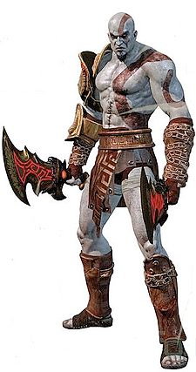
The Goals of Character Design
The ultimate goal of character design is to create characters that
  people find appealing and can believe in
  the player can identify with (women identify with their avatars more than men)
Avatars can be:
  specific (detailed with background) or non-specific (your ship in Galaga)
  controlled directly or “loosely” (sort of tell them where to go)

Slide 14
Visual Appearances
Humanoids, non-humanoids, hybrids
Art-driven character design
  Best method for simple characters who don’t change during the game
  Often are stereotypes!
  Avoid hyper-sexualization!
Story-driven character design
  Best method for complex characters or characters who change during the game

Slide 15
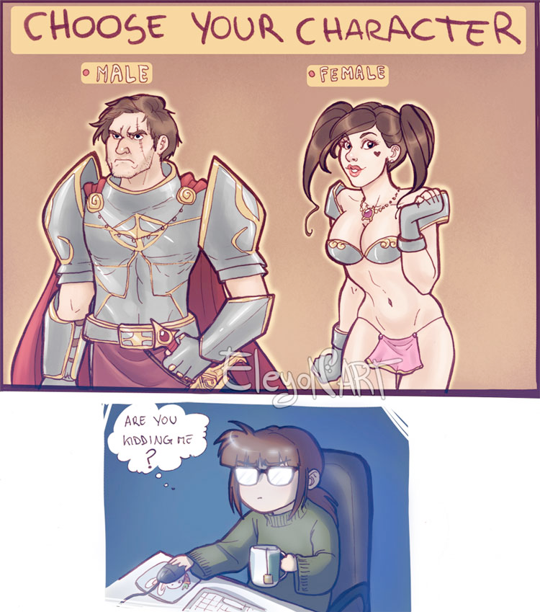
Character Physical Types

Slide 16
When designing characters, think of:
Choice of weapons/clothing and other attributes reveals something about that character
Use a signature color for the main character
Sidekicks allow you to give the player additional moves and actions, and can be used to give the player information he wouldn’t get any other way
Background info can be provided many different ways within a game!

Slide 17
Character Growth
Characters can have multiple emotional states (0D to 3D)
Games often use physical growth because it is easy to show and implement
May follow the Hero’s Journey

Slide 18
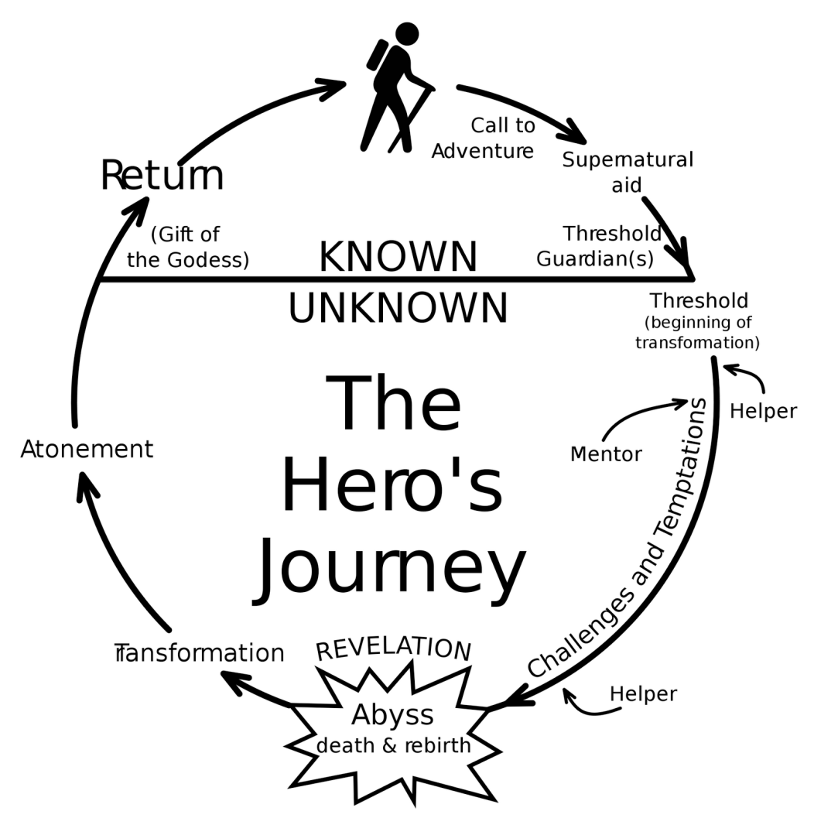
Key Concepts

Slide 19
Stories in Games
Entertainment, wider audience, maintain interest
Narrative is the part of the story told to the player by the designer (long cutscenes should be interruptible)
Narrative/story should not be more important than gameplay – gameplay alone can tell a story
  https://www.youtube.com/watch?v=JQJA5YjvHDU
Narrative must be triggered by the game mechanics appropriately

Slide 20
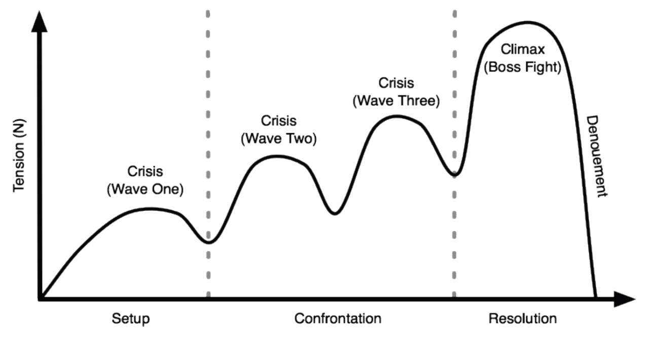
Tension
Dramatic tension and gameplay tension
  Dramatic tension comes from the story
    Fades in the presence of randomness and repetition

Slide 21
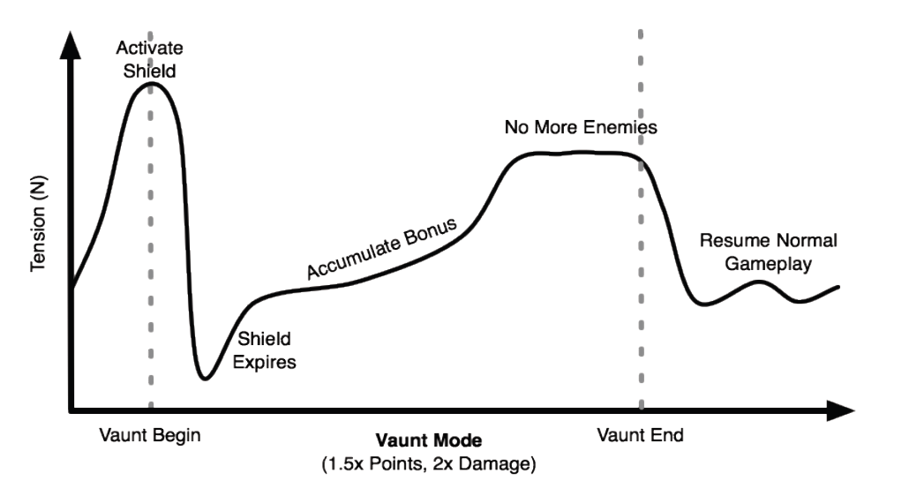
Tension
  Gameplay tension comes from the challenges (gameplay)
    Tolerates randomness and repetition for much longer

Slide 22
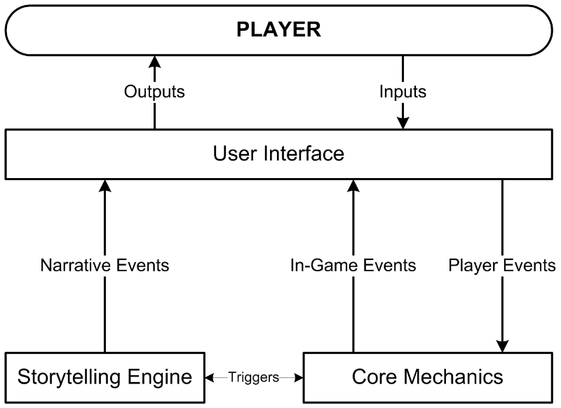
The Storytelling Engine
    How frequently should these triggers happen?

Slide 23
Linear Stories
Players cannot change the story
  Challenges are part of the story
  Pros and cons of linear stories:
They require less content than nonlinear ones
The storytelling engine is simpler
They are less prone to bugs and absurdities
They are capable of greater emotional power
They deny the player dramatic freedom
They reduce the replay-value of the game

Slide 24
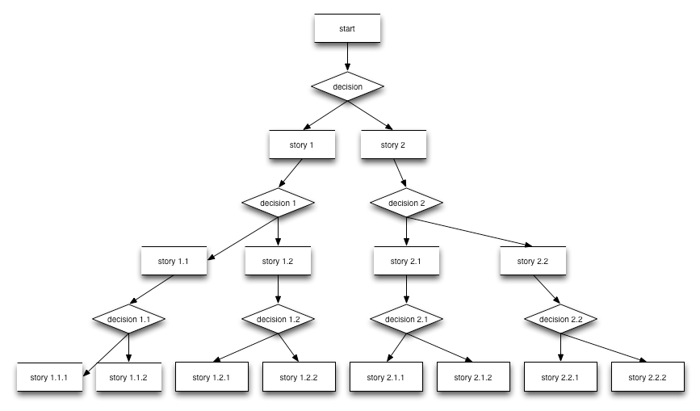
Nonlinear Stories
Branching stories

Slide 25
Nonlinear Stories
Foldback stories
  Compromise between branching and linear stories
  Plot branches, but the branches fold back into a single inevitable event
Emergent narrative
  Storytelling produced entirely by player actions
Endings
  Include multiple endings to provide an outcome that reflects the player’s dramatic actions
  Should provide an emotionally satisfying conclusion

Slide 26
When to Write the Story
Make a list of episodes or levels during the concept stage
Write the story during the elaboration stage
  Remember that you are creating an interactive game, not writing a novel

Slide 27
Fun stuff
The first game to have a complex backstory was the arcade game Millipede (Atari, 1982).
  Since technology of the time limited what you could portray at the beginning of the video game, Atari chose to put the backstory on a poster and flyer that was distributed in the arcades.
  This backstory, The Archer and the Millipede, is shown on pg 82 of your book - you will notice 11 carefully crafted elements designed to get players of the time to engage with the game.

Slide 28
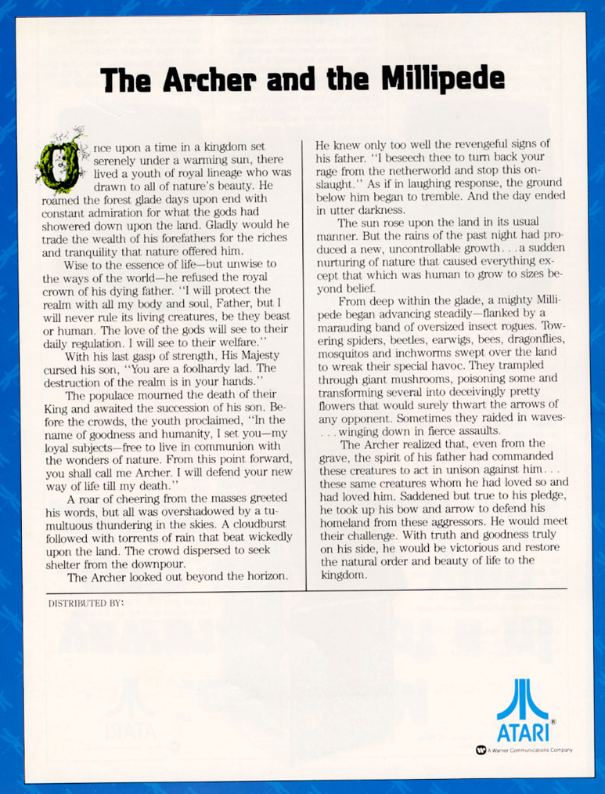

Slide 29
What Are the Core Mechanics?
Core mechanics consist of algorithms and data that precisely define the rules
  Implementation of mechanics varies as project goes through design process
  Player does not experience core mechanics directly
The game engine is the part of the software that implements the game’s rules

Slide 30
What Are the Core Mechanics?
Real-time games versus turn-based games
  In a real-time game, many mechanics are processes that operate continuously
  In a turn-based game, mechanics compute the effects of the player’s actions after each turn
Core mechanics and level design
  Design should specify how challenges work in general but not which challenges each level will contain

Slide 31
Key Concepts
A resource is a type of object or material that can move or exchange within the game
  Resources are handled as numeric quantities
  Core mechanics define how resources are used or traded and how they enter and leave the game
  Note: resources are not objects but types of objects
    “Pencils” are a resource
    “This pencil” or “these 3 pencils” are entities

Slide 32
Key Concepts
An entity is an instance of a resource or the state of some element of the game world
  A simple entity is defined by one attribute
  A compound entity is defined by multiple attributes
  A unique entity occurs when the game world contains only one entity of a specific type

Slide 33
Key Concepts
Mechanics document how the game world and everything in it behaves
  States the relationships among entities
  A global mechanic operates throughout the game
  Identifies the events and processes that take place among the resources and entities
  Tracks the conditions that trigger events and processes

Slide 34
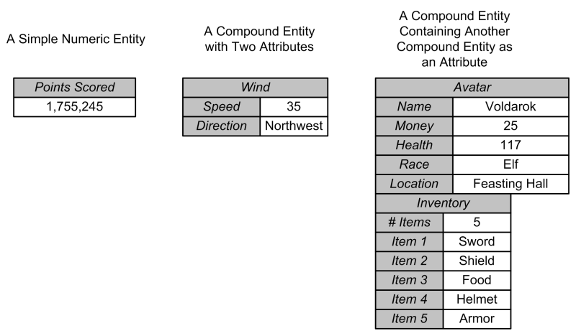
Example: Entity

Slide 35
Key Concepts
A source is how a resource or entity comes into the game world
  A mechanic identifies a spawn point, its location, the generated resource, and the frequency
  Sources can produce resources automatically when started by the player
  Sources can be global mechanics
  Sources can be limited or unlimited

Slide 36
Key Concepts
Drains remove resources from the game
Converters turn a resource into a different type of resource
Traders change the ownership of resources
Production mechanisms make a resource available to players

Slide 37
Core Mechanics and Gameplay
Core mechanics present challenges to the player and accept actions from the player
  Core mechanics implement the mechanisms to operate challenges
  Core mechanics perform tests to see if a challenge has been surmounted
  Passive challenges (such as static obstacles) do not require mechanics to operate
  Active challenges require mechanics that implement their activity

Slide 38
Designing the Core Mechanics
Goals of core mechanics design
  Keep it simple and elegant
  Create generalized systems from patterns
  Use iterative refinement
  Provide details when appropriate

Slide 39
Designing the Core Mechanics
Revisit earlier design work on the project to identify entities and mechanics
  Nouns in design documents will probably be implemented as entities or resources or both
  Verbs are actions that will be implemented as mechanics
  “If” and “when” statements identify conditions that trigger and control mechanics

Slide 40
Designing the Core Mechanics
List the entities and resources
  Does a noun describe a resource or an entity?
  If an entity, is the entity simple or compound?
  If a compound entity, what attributes describe it?

Slide 41
Avoiding Dominant Strategies
Dominant strategies in video games
  Transitive relationships among three or more entities
    If A > B and B > C, then A > C
      Never any reason to choose B or C if A is best
    To correct the imbalance, assign costs to each choice
    To create a more interesting choice, impose shadow costs for choices
    Transitive relationships often used to create upgrades for a player’s abilities—start with C and earn B, then A

Slide 42
What Is a Balanced Game?
A well-balanced PvP or PvE game has the following characteristics:
  It provides meaningful choices
    It avoids dominant strategies
    Each strategy must have a reasonable chance of producing victory
  Player’s skill must affect success
    Role of chance should not be so great that player skill becomes irrelevant

Slide 43
Making PvP Games Fair
To balance symmetric games, treat every player the same
  Same rules, resources, victory conditions
Asymmetric games are harder to balance
  Give players identical quantities of materials or points when they start
  Players spend points to build units as they wish
  Unit attributes should differ among players

Slide 44
Making PvE Games Fair
A fair PvE game should
  Offer challenges at a consistent level of difficulty
  Avoid learn-by-dying designs
  Avoid stalemates
  Provide information for critical decisions
  Avoid requiring extrinsic information
  Include challenges appropriate for the genre

Slide 45
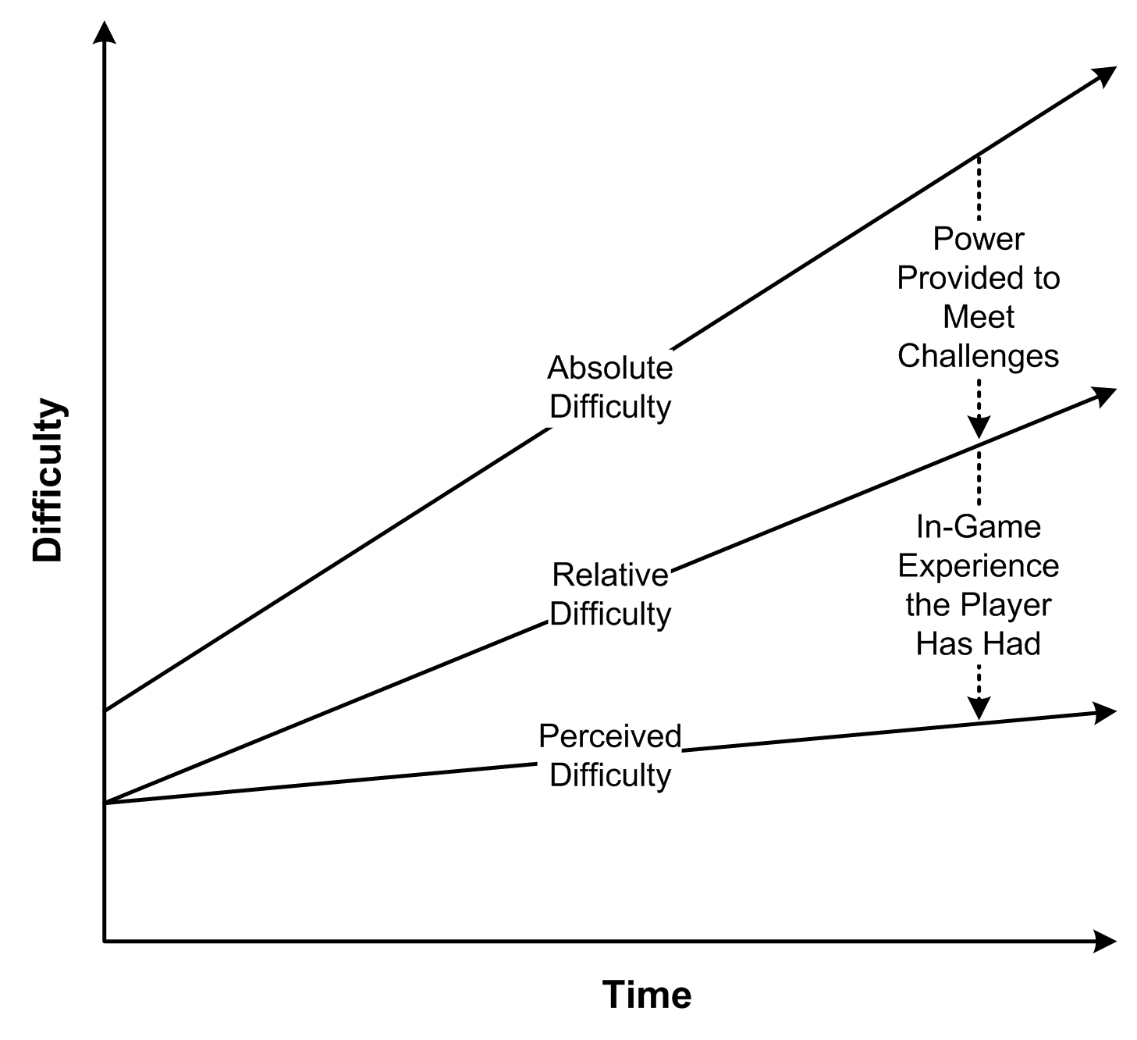
Managing Difficulty

Slide 46
Managing Difficulty
Creating a difficulty progression
  Perceived difficulty of challenges should stay the same or rise
    In games for casual players and young children, it should remain almost flat
  Relative difficulty must increase over time to counteract the player’s growing in-game experience

Slide 47
Managing Difficulty
Establishing difficulty modes
  In single-player games, allow player to choose a difficulty mode
  When a difficulty mode is selected, challenges must stay within that range
  If you can’t adjust the difficulty of a challenge, provide a way around it for the easy mode and block the go-around route for the hard mode

Slide 48
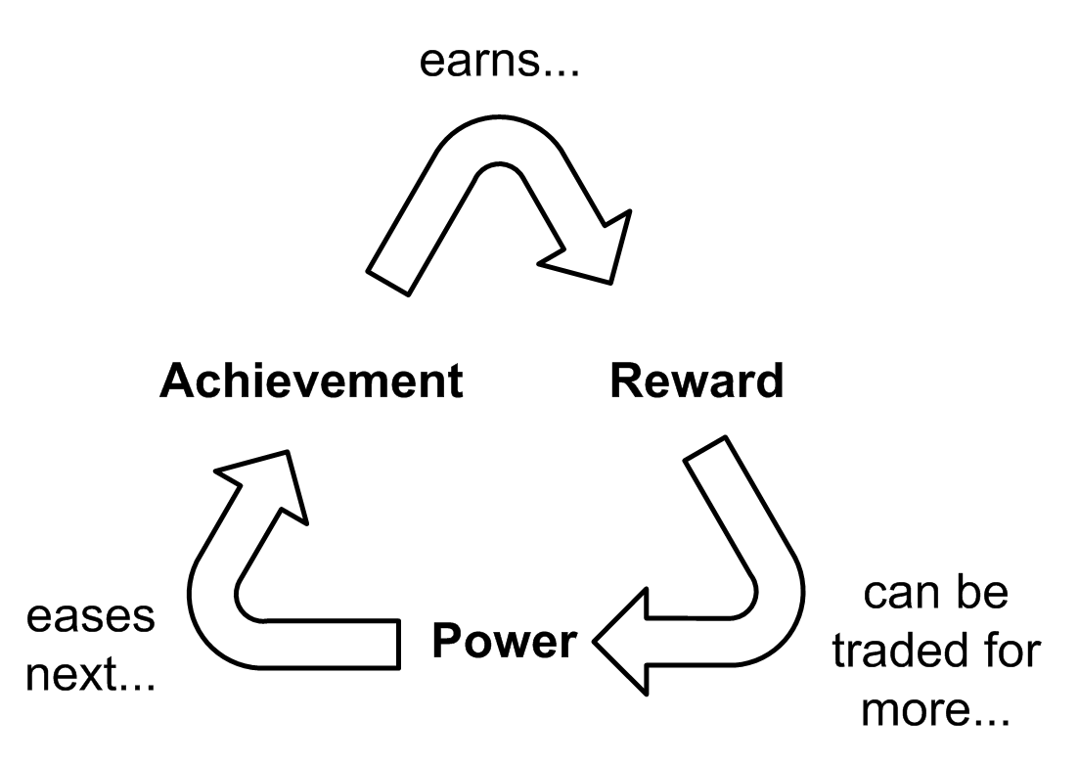
Understanding Positive Feedback
Positive feedback occurs when a player’s achievement changes the game state, making future achievements easier
Benefits of positive feedback
  Discourages a stalemate
  Rewards success

Slide 49
Understanding Positive Feedback
Controlling positive feedback
  Don’t give too much power as a reward
  Introduce negative feedback
  Raise the absolute difficulty level of challenges as the player proceeds
  Allow collusion against the leader
  Define victory as unrelated to the feedback cycle
  Use chance to reduce the size of the rewards

Slide 50
Other Balance Considerations
Avoid stagnation
  Stagnation occurs when the player does not know what to do next
    Hide clues in plain sight about how to proceed
    Have the game detect when the player is wandering aimlessly and provide nudges in the right direction
Avoid trivialities
  Let the computer handle uninteresting details of game

Slide 51
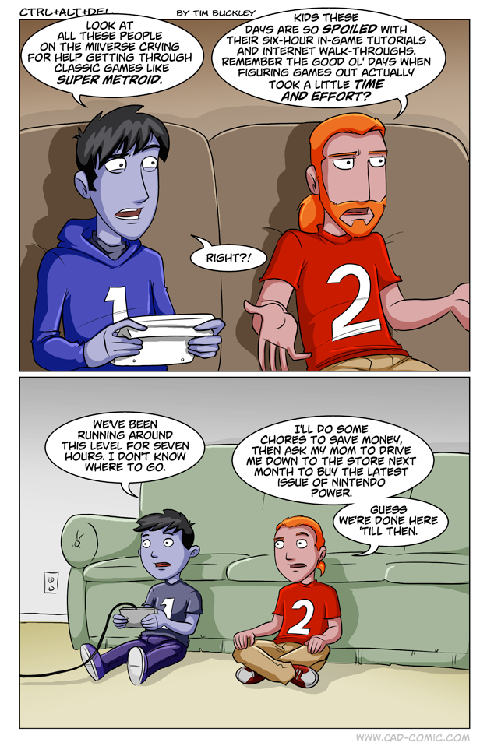

Slide 52
Design to Make Tuning Easy
Generalize mechanics when possible
  Try to avoid creating special cases
Separate code and data
Suggestions for efficient fine-tuning:
  Modify only one parameter at a time
  When modifying parameters, make big adjustments—the consequences are easier to see
  Keep records
  Use pseudo-random numbers

Slide 53
What Is Level Design?
Level Design
  Constructing the experience for the player using components from the game designer
  Level Designers create:
Space in which the game takes place
Initial conditions of the level
Set of challenges within the level
Termination conditions of the level
Interplay between gameplay and story
Aesthetics and mood of the level

Slide 54
Key Design Principles
Universal level design principles
  Make the early levels of a game tutorial levels
  Vary the pacing of the level
  When the player surmounts a challenge that consumes his resources, provide more resources
  Avoid conceptual non sequiturs
  Clearly inform the player of his short-term goals

Slide 55
Key Design Principles
Universal level design principles
  Be clear about risks, rewards, and consequences
  Reward the player for skill, imagination, intelligence, and dedication
  Reward in a large way, punish in a small way
  The purpose of an artificial opponent is to put up a good fight and then lose
  Implement multiple difficulty settings

Slide 56
Key Design Principles
Genre-specific level design principles
  Action game
    Vary the pace
  Strategy game
    Reward planning
  Role-playing game
    Offer opportunities for character growth and player self-expression
  Sports game
    Realism is vital
  Vehicle simulation
    Reward skillful maneuvering

Slide 57
Key Design Principles
Genre-specific level design principles
  Construction and management simulation
    Offer an interesting variety of initial conditions and goals
  Adventure game
    Construct challenges that harmonize with their locations and the story
  Artificial life game
    Create many interaction opportunities for the creatures in their environment
  Puzzle game
    Give the player time to think

Slide 58
The Level Design Process
Design to level design handoff
  List features in the level
  Create a rough overview map of the level
Planning phase
  Plan the level in detail
  Plan the sequence of events
  Document the gameplay, art, performance, and code requirements

Slide 59
Pitfalls of Level Design
Get the scope right
  Design within your available resources
  It’s common to design something that’s too big
Avoid illogical events
  Illogical events in a game make it harder to play
  Players should be rewarded for using their intelligence

Slide 60
Pitfalls of Level Design
Make atypical levels optional
  Atypical levels break the player’s suspension of disbelief
  Atypical levels could prevent some players from completing the game
Don’t show the player everything at once
  Introduce new features gradually
  Maintain the player’s interest

